Slide 1



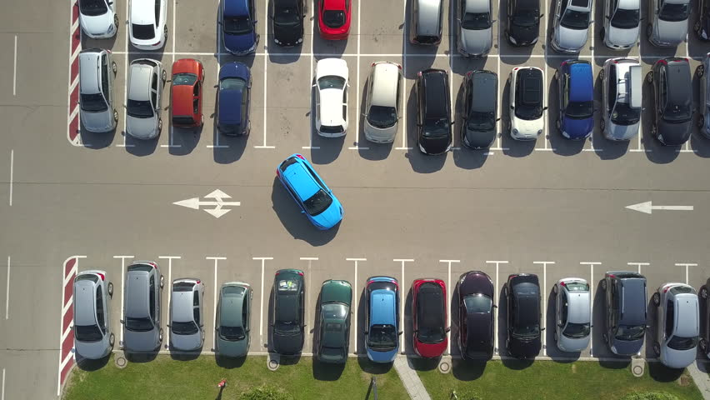
UNIVERSITY COLLEGE OF ENGINEERING RAMANATHAPURAM
INTERNET OF THINGS
SMART PARKING
PROJECT PHASE 2 INNOVATION
A.WAZIL 913021104042
A.REVATHI 913021104025
R.THIRUMAGAL 913021104036
R.NIVETHITHA 913021104018

Slide 2
CONTENTS
INTRODUCTION
ABSTRACT
BLOCK DIAGRAM
WORKING PRINCIPLE
FLOWCHART

Slide 3
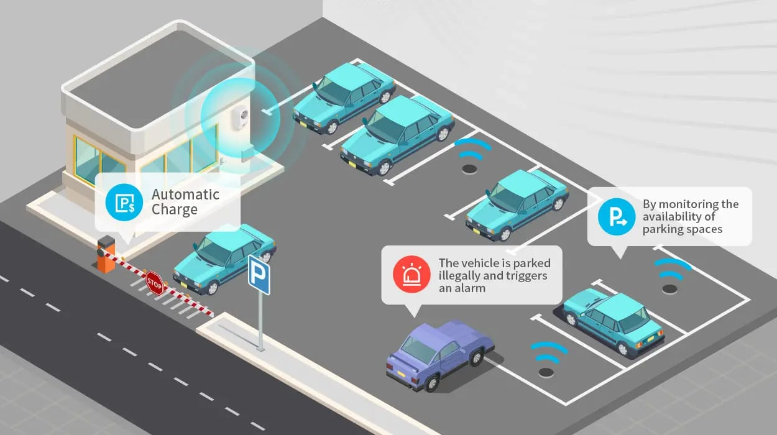
INTRODUCTION
Image Processing for Parking Space Detection describes an image processing method that can be used to capture the brown circle painted on the parking spot and determine whether or not that space is free or reserved.
Parking space detection system that uses image processing. The system employs Deep Neural Network (DNN) algorithm and image processing techniques to locate open parking slots.

Slide 4
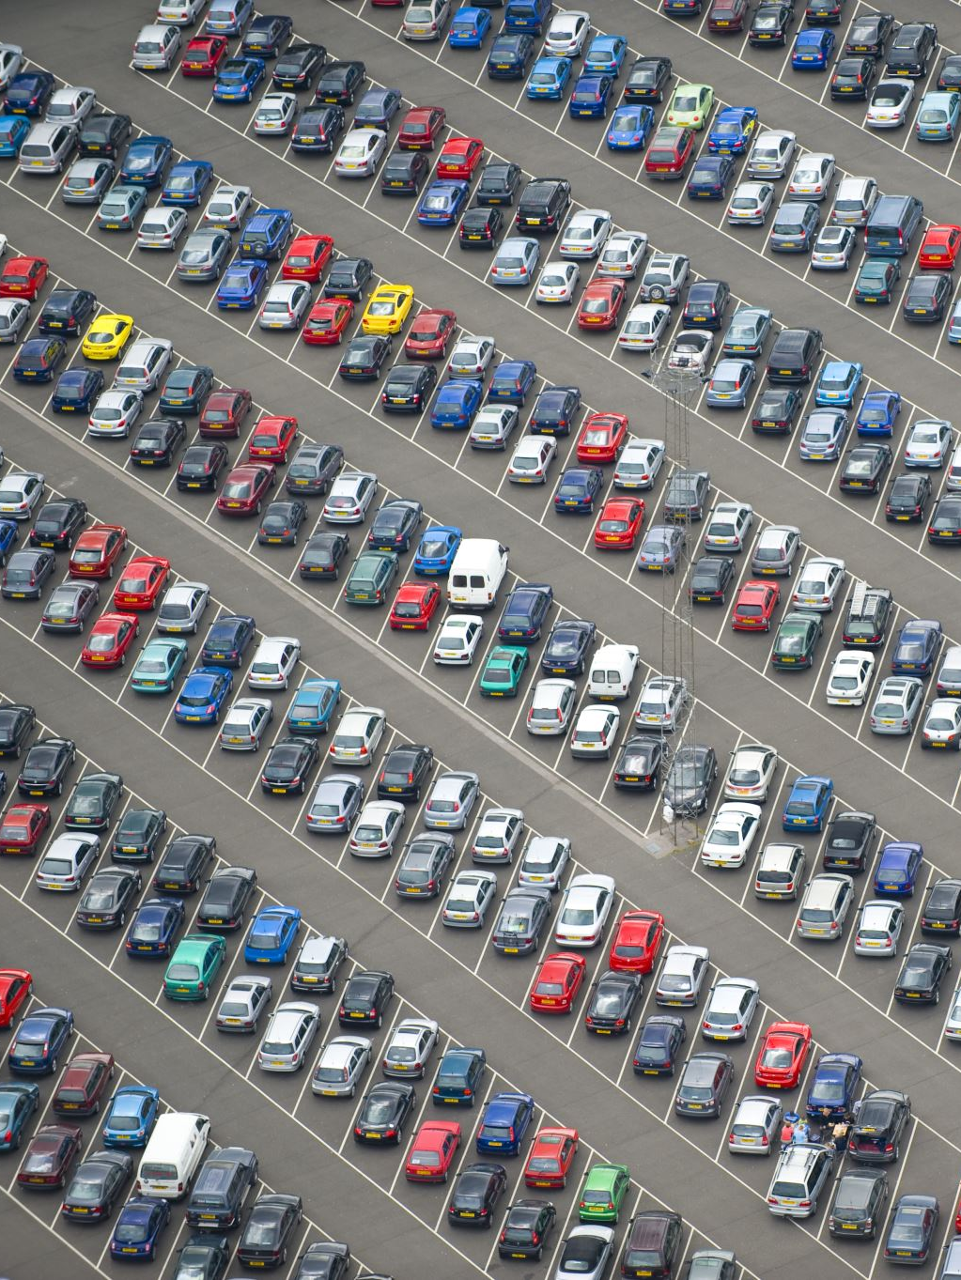
ABSTRACT
With the ever-increasing urbanization and the proliferation of vehicles, efficient management of parking spaces has become a critical challenge in modern cities. This paper presents a novel approach to address this issue through the use of image processing techniques for real-time detection of available parking spaces in parking lots and on-street parking areas.

Slide 5
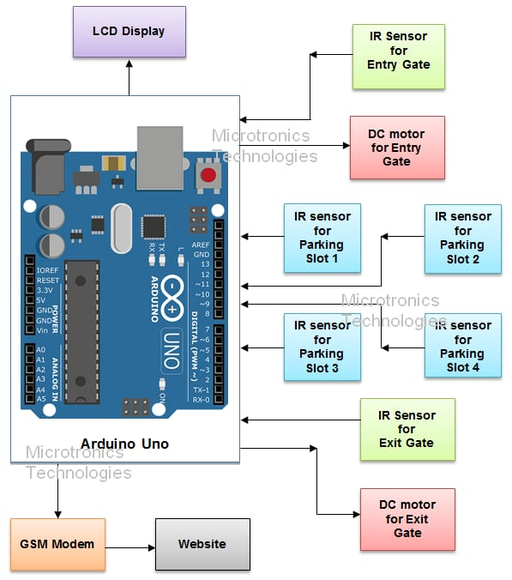
BLOCK DIAGRAM

Slide 6

WORKING PRINCIPLE
Image Acquisition:
Use cameras or other image-capturing devices to capture images or video streams of the parking area. These cameras can be stationary, mounted on poles or walls, or even integrated into vehicles for mobile applications.
Image Preprocessing:
Enhance the quality of the acquired images through preprocessing techniques such as noise reduction, contrast adjustment, and image stabilization. This step ensures that the subsequent processing steps are more accurate and reliable.
Object Detection:
Apply object detection algorithms to identify vehicles within the images. Common object detection methods include Convolutional Neural Networks (CNNs), YOLO (You Only Look Once), and Faster R-CNN. These algorithms can detect and locate vehicles in the image.
Region of Interest (ROI) Selection:
Define regions of interest within the parking area where parking spaces need to be monitored. Exclude areas like driveways or lanes where vehicles should not be parked.
Parking Space Segmentation:
Divide the ROI into individual parking spaces. This can be done manually by marking parking space boundaries in a reference image or automatically using image segmentation techniques. Common methods include thresholding, contour detection, or semantic segmentation.

Slide 7
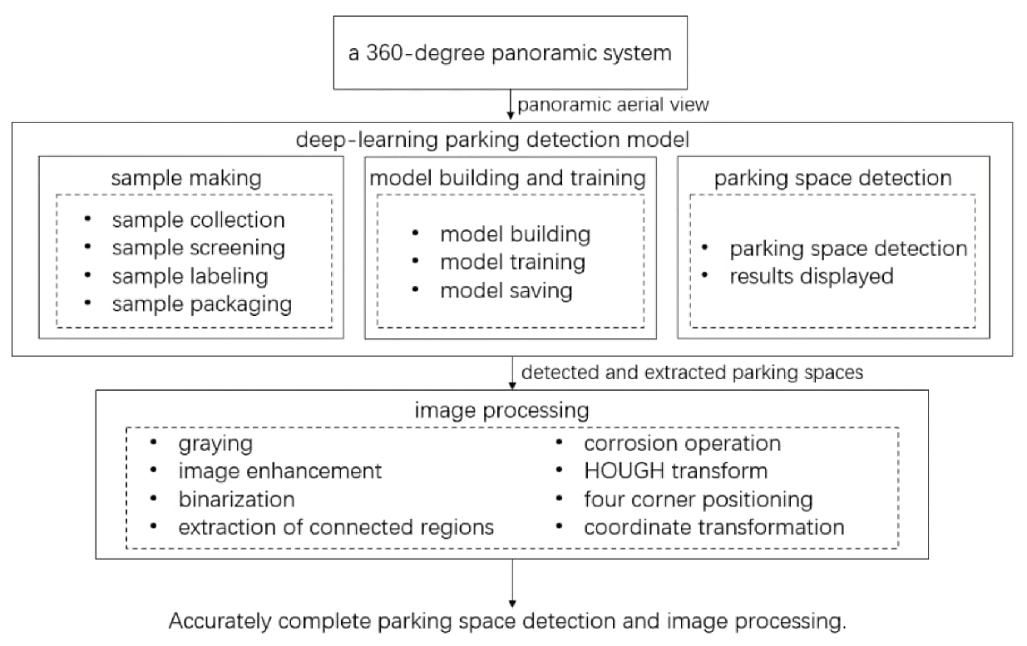
FLOWCHART

Slide 8
THANK YOU

